Slide 1
ƒ
Pain-free inheritance with F.js

Slide 2
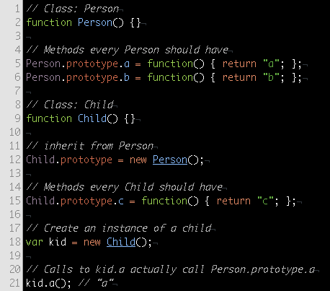
JavaScript Inheritance
JS is prototype-based
Existing objects are used as a blueprint, or prototype, for new objects
Results in a prototype chain that ends with Object
Method and property lookup happens by traversing the prototype chain

Slide 3
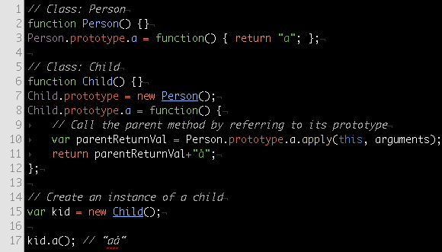
JavaScript Inheritance: Superclass Methods
Must know parent class and directly refer to its prototype
Awkward syntax
Doesn’t work if immediate parent doesn’t implement the method

Slide 4
JavaScript Inheritance
It’s painful.
The syntax is ugly.
It’s hard to understand from a classical background.

Slide 5
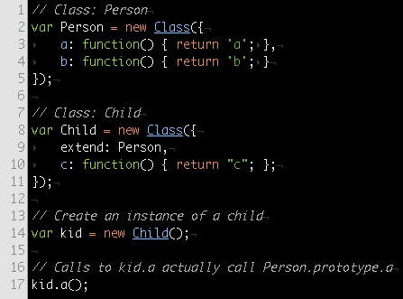
Inheritance with Class
Class is F’s inheritance model
Simplified syntax
Works the same way under the hood
Gives you a few things for free

Slide 6
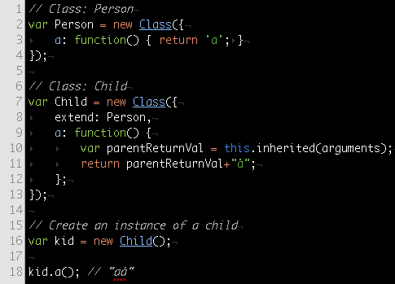
Inheritance with Class: Superclass Methods
Do not need to know parent class
Simple syntax
Works if immediate parent does not implement called method

Slide 7
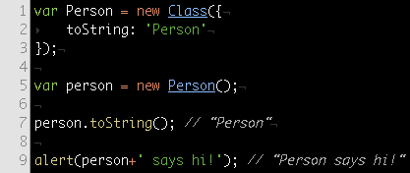
Inheritance with Class: The toString Method
Used heavily by F, recommended for better stacktraces
Can be defined as a method or a string
Inherits from parent if not defined

Slide 8
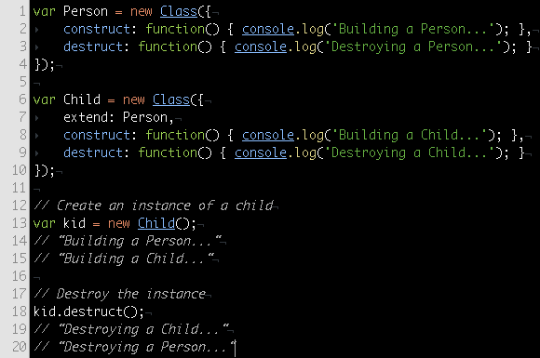
Inheritance with Class: Constructors & Destructors
Defined with construct and destruct
Chained automatically: parent constructors first, child destructors first
construct is always passed an empty object if no arguments are provided

